Slide 1

Online learning Platform
Powered by MERN Stack
Khushi Khendalwal

Slide 2
Overview
In the digital age, online learning platforms have revolutionized education by making quality content accessible to a global audience. The development of such platforms involves a combination of innovative technology and user-centric design. This project aims to create a robust online learning platform using the MERN stack, which encompasses MongoDB, Express.js, React.js, and Node.js, to provide a comprehensive and interactive learning experience.

Slide 3
Key Features
1. User Management:
Registration and login for students and instructors.
Role-based access control (RBAC).
2. Course Management:
CRUD operations for courses (Create, Read, Update, Delete).
Instructor dashboard for course creation and management.
3. Course Enrollment:
Students can browse and enroll in courses.
View and manage enrolled courses.
4. GPT-3 Integration:
Personalized course recommendations based on user interests and goals.

Slide 4
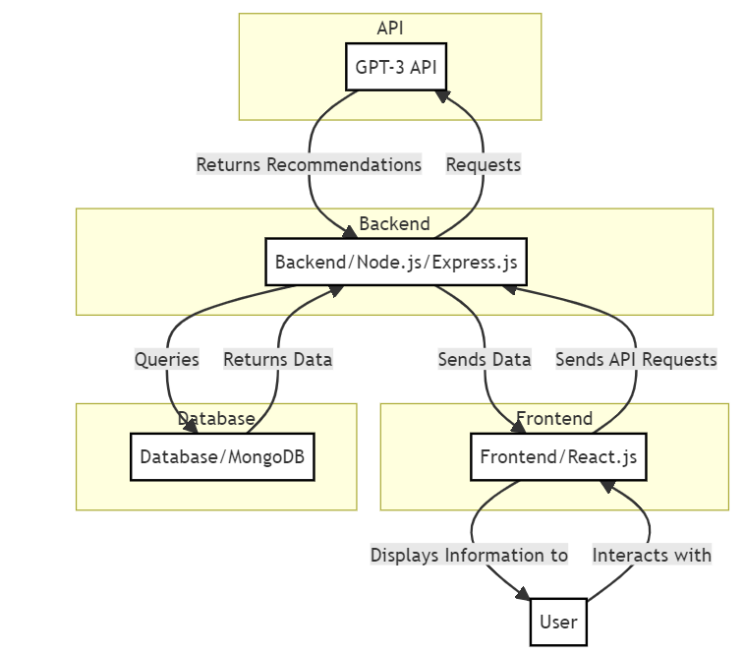
System Architecture

Slide 5
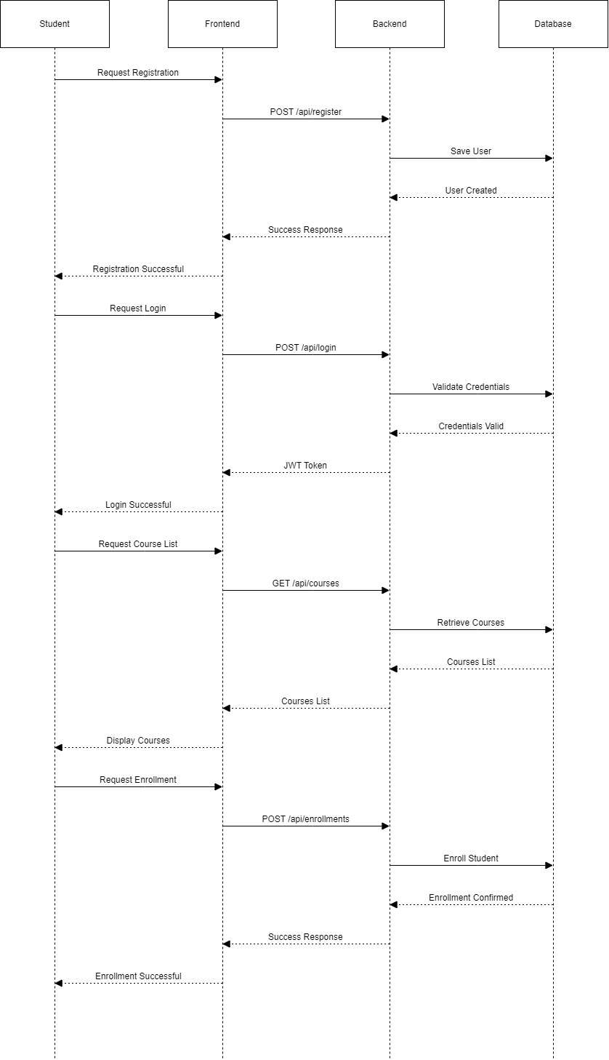
Sequence diagram

Slide 6
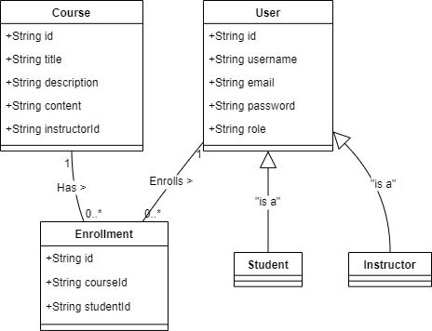
Class diagram

Slide 7
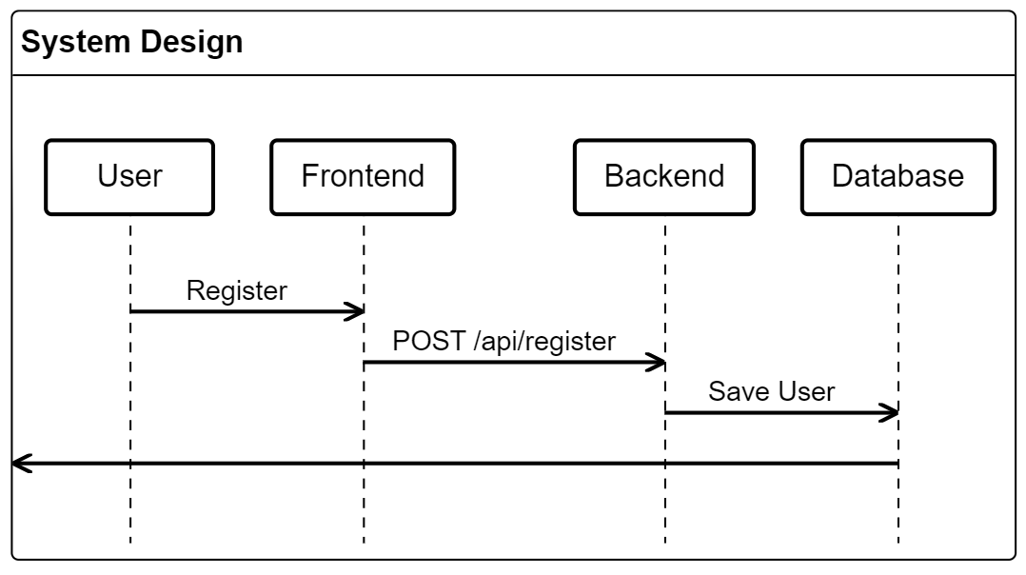
UML diagram

Slide 8
UML diagram

Slide 9
Technical requirements
Component | Technology/Tool | Description
Backend | Node.js, Express.js | Server-side framework for building RESTful APIs and handling logic.
Authentication | JWT (JSON Web Tokens) | Secure method for handling user authentication and authorization.
Frontend | React.js | JavaScript library for building the user interface and managing state.
Database | MongoDB | NoSQL database for storing user data, courses, and enrollments.
API Integration | GPT-3 API | External API for providing personalized course recommendations.
Deployment | Azure or equivalent | Cloud service for hosting the application and managing infrastructure.
Version Control | Git | Tool for source code management and version control.
Development Tools | Visual Studio Code, GitHub | IDE and repository hosting for development and collaboration.
Testing | Jest, Postman | Framework for unit testing (Jest) and API testing (Postman).

Slide 10
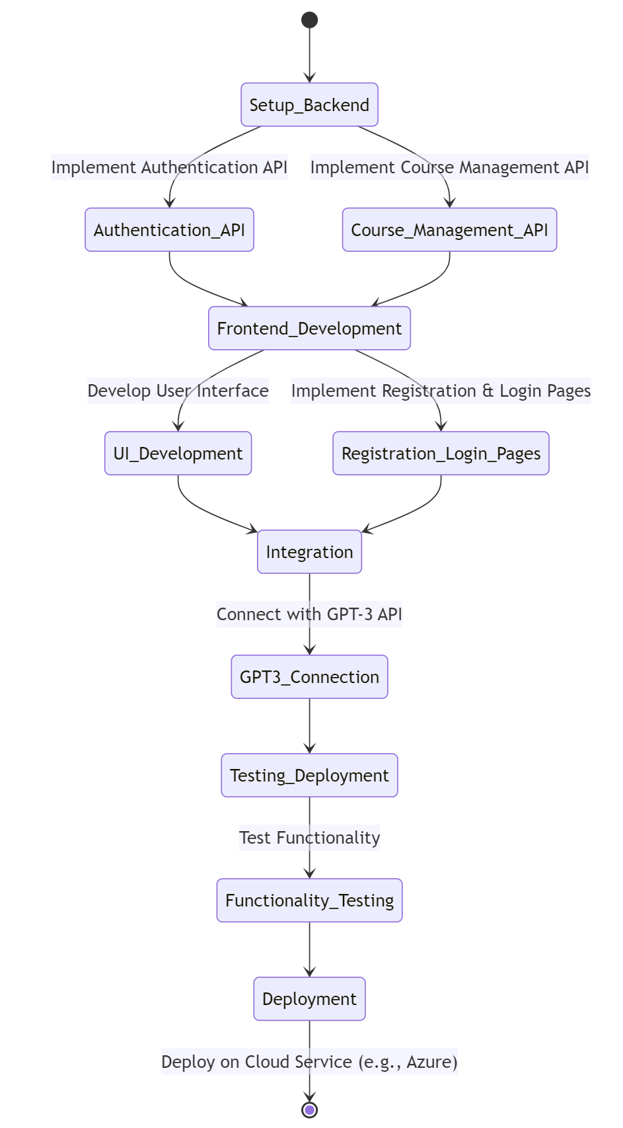
Implementation steps

Slide 11
Challenges & Solutions
Challenge | Solution
Handling Complex User Roles and Permissions | Implement a robust role-based access control (RBAC) system using JWT. Define user roles clearly (student, instructor, admin) and ensure proper access restrictions.
Integrating GPT-3 API for Accurate Recommendations | Fine-tune GPT-3 prompts and settings to better align with user needs. Implement thorough logging and feedback loops to adjust recommendations based on user interaction.
Managing Real-Time Course Enrollment Updates | Use WebSocket or polling mechanisms to update course enrollment statuses in real-time. Ensure the frontend dynamically reflects changes without requiring a full page reload.
Optimizing MongoDB Queries for Performance | Implement indexing and optimize queries to handle large volumes of data efficiently. Regularly review and refine queries to ensure performance remains acceptable as the data grows.
Ensuring Cross-Browser Compatibility and Responsiveness | Test the application across multiple browsers and devices. Use CSS frameworks like Bootstrap or media queries to ensure a consistent user experience across different screen sizes and browsers.

Slide 12

Q & A

Slide 13
Thank You

